Slide 1

ENME480 Lab Week 5/6: Forward Kinematics
Alex Beyer, Kaustubh Joshi

Slide 2
Announcements
Late assignments
Reach out to us before the assignment is due!
For labs we will give extensions where we can (within reason)
The labs build on each other, so falling behind will make your life and your groups lives harder!
Labs at RAL are much harder to make up
Labs at RAL are also very short, show up on time!

Slide 3
Todays Plan
FK Lecture
Solving the DH Table for the UR3
Validating last weeks measurements using a Python script

Slide 4
Methods
More than one way to do Forward Kinematics:
Transform Matrices
Screw Matrices
DH Parameters
This is where linear algebra becomes very important!
We’re interested in using DH Parameters
What would be important qualities for an FK method to have?

Slide 5
DH Parameters
Need to move our reference frame between joints
Ideally, the representation of each frame will be unique
We want to be able to “walk” along our chain of joints, moving our reference frame at each step
In ROS, MoveIt! (usually) handles our Forward Kinematics via DH Parameters

Slide 6
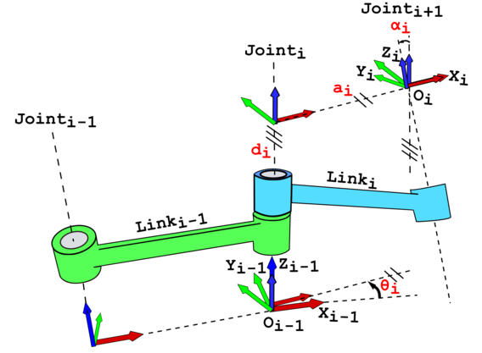
DH Parameters
Defines a transformation between joints i-1 and i
To set up:
Orient your z-axis through the joint
Along axis of rotation for revolute
Along axis of motion for prismatic
Point x along the member
Choose y to make a right handed frame

Slide 7
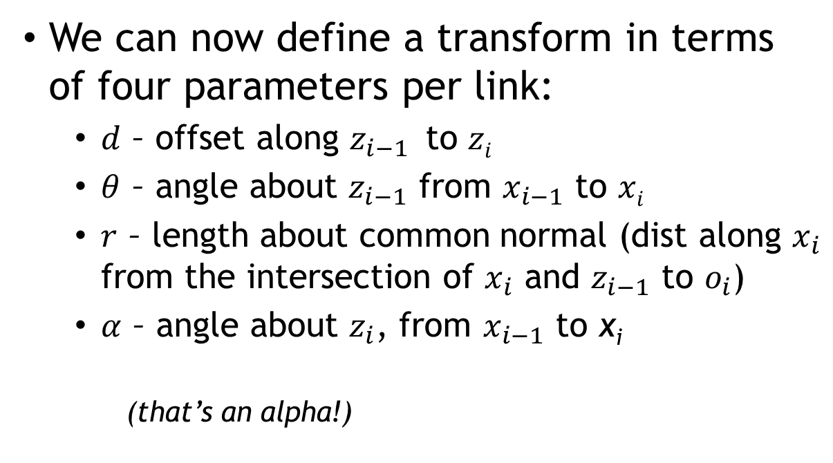

DH Parameters
We can now define a transform in terms of four parameters per link:
$d$ – offset along $z_{i−1}$ to $zi$
$θ$ – angle about $z_{i−1}$ from $x_{i−1}$ to $xi$
$r$ – length about common normal (dist along $x_{i}$ from the intersection of $x_{i}$ and $z_{i−1}$ to $o_{i}$)
$α$ – angle about $z_{i}$, from $x_{i−1}$ to x_{i}
(that’s an alpha!)
Some sources call this $a$

Slide 8
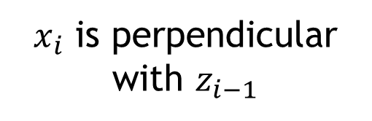
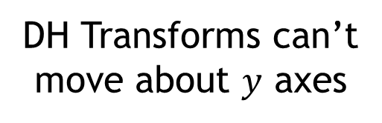
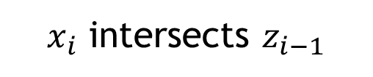
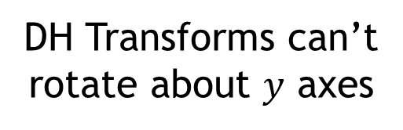
DH Constraints
DH Parameters come with two constraints which can be viewed in two ways:
(DH1)
$x_{i}$ is perpendicular with $z_{i−1}$
DH Transforms can’t rotate about $y$ axes
DH Transforms can’t move about $y$ axes
(DH2)
$x_{i}$ intersects $z_{i−1}$

Slide 9
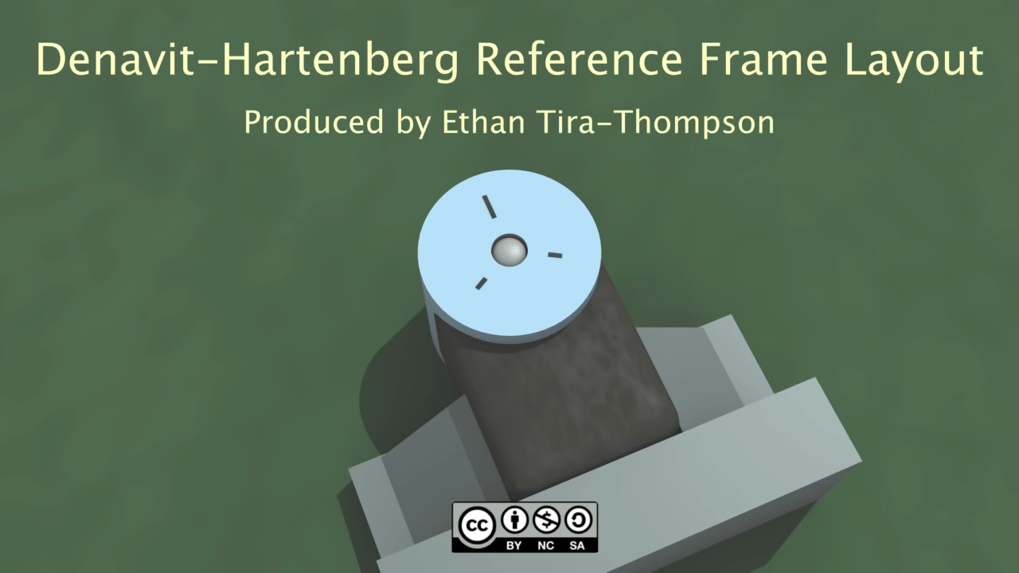
Credit to TekkotsuRobtotics on YouTube

Slide 10
DH Parameter Matrix
We can think of the DH Parameter Transformation as four transformations at once:
Translation along a joint axis (d)
Rotation about a join axis (θ)
Translation along a member (r)
Rotation about a member (α)

Slide 11
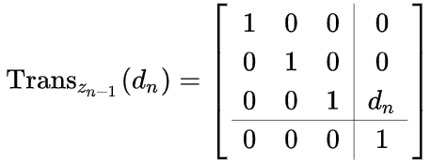
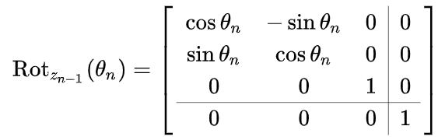
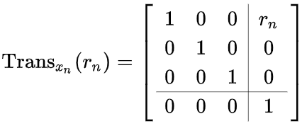
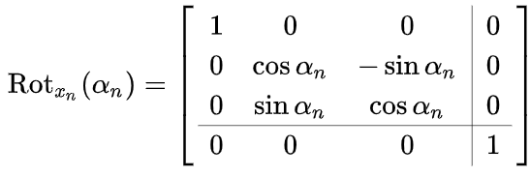
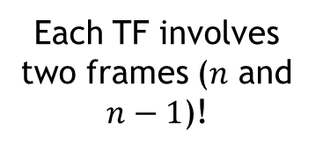
DH Parameter Matrix
When built, our four (single DoF) transforms look like:
Does this order matter? If so, why?
Each TF involves two frames ($n$ and $n−1$)!

Slide 12
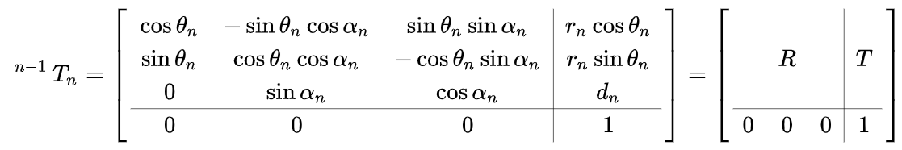
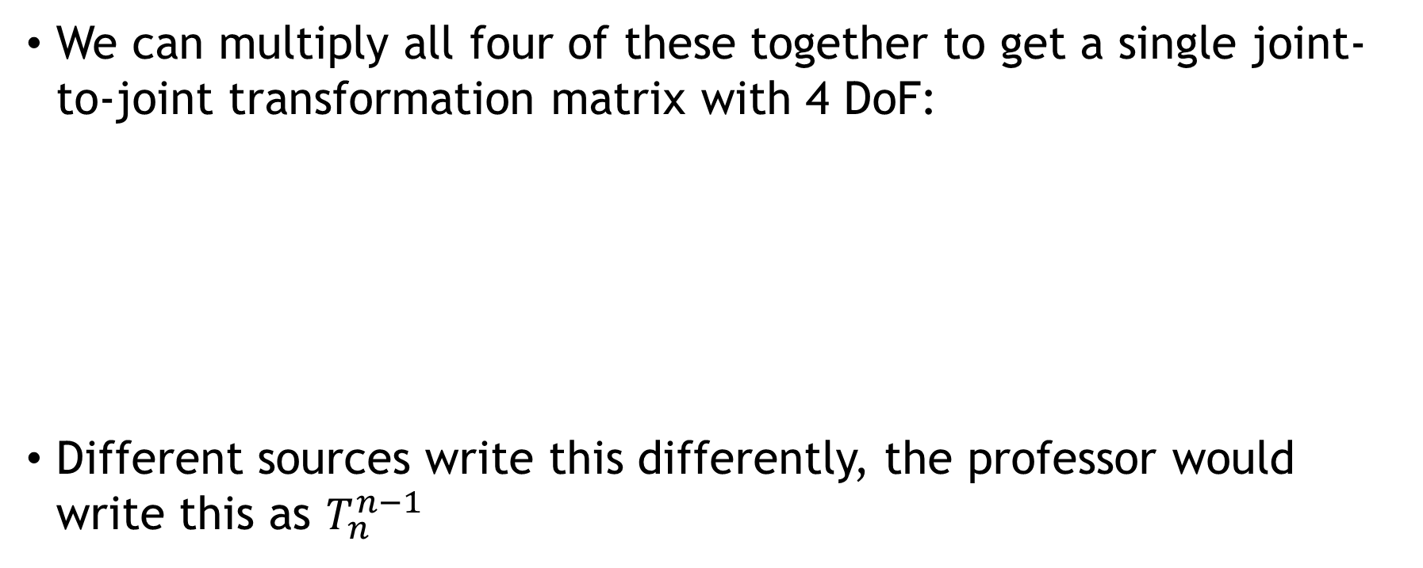
DH Parameter Matrix
We can multiply all four of these together to get a single joint-to-joint transformation matrix with 4 DoF:
Different sources write this differently, the professor would write this as $T_{n}^{n−1}$
Rotation
Transform
From frame n-1…
Translation
Transform
…to frame n

Slide 13

Using DH Parameters
In practice you won’t be doing this manually very often; most software will handle this automatically
Things break, so understanding this now will save you hours of frustration later
We’ve defined the transformation matrix from joint i to i+1, how do we continue this?
Multiply them!

Slide 14
Using DH Parameters
One advantage of DH Parameters is most joints only lead to 1 free parameter by convention:
Revolute Joints lead to a free θ
Prismatic Joints lead to a free d
All other transform parameters will be fixed for that frame, depending only on how the robot is built
Tip: Use tables!
Frame | d | θ | r | α
0 → 1 | d₁ | θ₁ | r₁ | α₁
… | … | … | … | …
n-1 → n | d_{n} | θ_{n} | r_{n} | α_{n}

Slide 15

Representing DH Parameters
There are lots of different ways to represent DH Params:
Some sources split the transform into a transform about z and a transform about x, so
Some sources replace parameter r with a (we use r to avoid confusion with parameter α)
There are also Modified DH Parameters which place the ith frame at joint i instead of the i+1th joint
We transform z(i-1) to z(i), then work on x(i)

Slide 16
Deliverables
Forward Kinematics Lab Assignment is due before your exam!
Check ELMS for specifics
Part of the assignment is Gazebo testing, let us know ASAP if your group is having problems!
Kaustubh will be giving a demo to help with the lab

